Slide 1
Electric Field Monte Carlo Simulation
R. Davis, M. Xu

Slide 2
What is the Monte Carlo Method?
Broad class of algorithms that rely on repeated random sampling to obtain numerical results
Follow the method:
Define a domain of possible inputs.
Generate inputs randomly from a probability distribution over the domain.
Perform a deterministic computation on the inputs.
Aggregate the results.

Slide 3
How does the Monte Carlo simulation work?
Random Number Generation
Attenuation of beam in the medium
Scattering of Photons
Variable weight photon
Index Mismatch of Boundary Layers
Grid Structure
Detector
Inverse MC (from detector Æ source)

Slide 4
Drunken Man Walk
After n steps
There is an equal probability of walking in any direction: left, right, up or down.

Slide 5
Simulating 100000 Drunken Men Walking
Gaussian distribution by central limit theorem:
Step Size: grid size

Slide 6
Problem with Light Simulation
The first example is predicting the step size of a photon between interaction events (absorption or scattering) as the photon multiply scatters within a medium
A photon takes a step (s [cm]) whose length is exponentially distributed, and depends on the value of the total attenuation coefficient µt [cm-1 ] equal to µa + µs
µa is the absorption coefficient
µs is the scattering coefficient.
The value 1/µs is the photon’s scatter mean free path-length before absorbtion

Slide 7
What is the EMC?
Most conventional Monte Carlo simulations trace the Stokes vector
Recently, the Electric field Monte Carlo (EMC) method was developed to simulate polarized light propagating through turbid media
The electric field, rather than the Stokes vector, of light is traced in EMC
Notes:
The complete phase of light is accrued from both light scattering by particles and propagation through the host medium. EMC is hence most amenable to study coherence phenomena of multiple scattering light

Slide 8
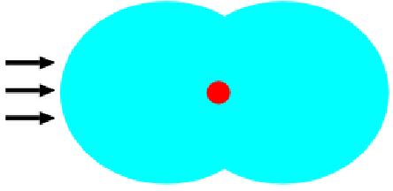
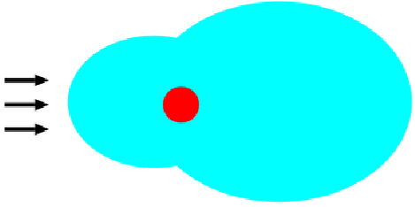
The Problem With Light
Small Scatterer (<λ)
Large Scatterer (λ)
Phase function p(θ,φ)
Isotropic scattering
(Rayleigh scattering)
Forward scattering
(Mie scattering)
Notes:
Propagation of multiply scattered light diffuses through the medium when light is sufficiently scattered. The previous simple 1D picture though is not enough.
In reality, random walk of photon may be in 2D or 3D space, and moreover, it is not isotropic. Light is not scattered to the left or right with equal probability.
Light is anisotropic ally scattered.

Slide 9
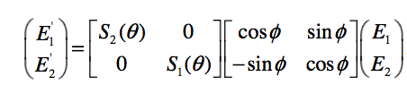
S Matrix
E1 and E2 are the complex parallel and perpendicular components of the incoming
electric field and E' and E' are the complex electric field components after the scattering event.
Notes:
The properties of the scattering particle are contained in the S matrix: S1 and S2 dependent on the refractive indices inside and outside the particle as well as the size of the
particle and the wavelength of the incident light.

Slide 10

EMC Explained
n
n'
s
m
s'
m'
Notes:
E is the complex electric field with components parallel and perpendicular to the previous scattering plane,
E' is the complex electric field with components parallel and perpendicular to the present scattering plane,
S is the amplitude scattering matrix dependent on the scattering angle θ between the incoming propagation direction and outgoing propagation direction, and
R is the rotation matrix dependent on the angle φ between the incoming perpendicular electric field component and the outgoing perpendicular electric field component.
The rotation matrix R rotates the reference frame φ degrees azimuthally to align the incoming perpendicular electric field component to the normal of the present scattering plane

Slide 11
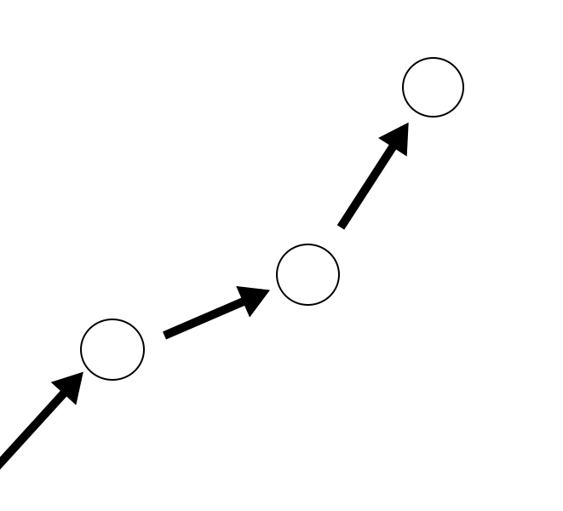

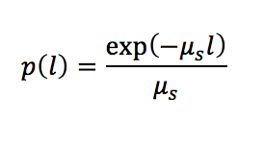
1
1
1

Slide 12
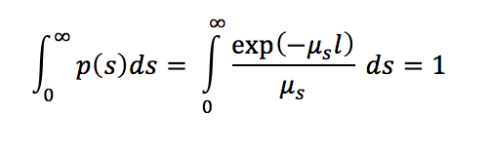
Cont.
Specify a properly normalized probability density function that describes the probability of a particular step size s
Notes:
Scattering coefficient controls the path length.
Absorption attenuates frontal weight

Slide 13
Problems Encountered Thus Far
Had some problems compiling programs
Programs were designed for older versions which to get a better understanding of how they worked, installed Linux on VM Ware

Slide 14
Things done so far
Being able to get the simulation code working
Understanding the Electric Field Monte Carlo simulation code
Being able to replicate previous results using the code

Slide 15
Things to do next
Edit the Monte Carlo simulation code to accommodate for the Faraday Effect
Simulate the detection of Glucose with the code
Write Report on project

